Slide 1
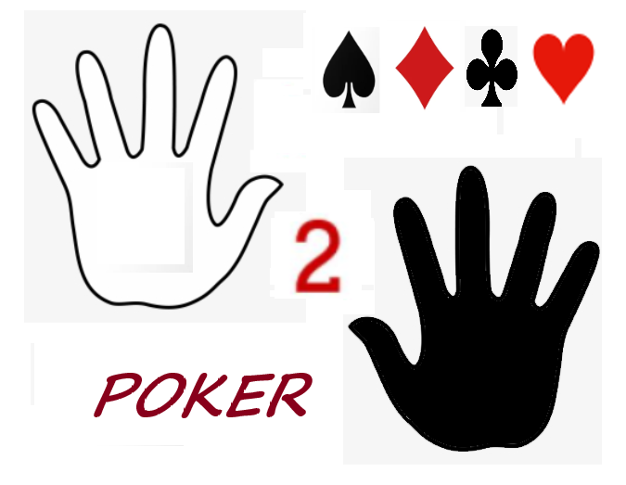
Hand 2 Hand Poker Presentation
Duroje Gwamna

Slide 2
Premise
Hand 2 Hand Poker is a "quick draw" style poker simulation. (No raises, antes, etc.)
Can view a list of hands from Screen
Player and dealer are both dealt 5 cards from one Deck object
Each hand is analyzed for matches (e.g. Royal Flush, Straights)
Player wins if hand is ranked higher than the dealer, or vice versa, using internal point system. Will check for the highest card if hands are identical
Can play for however long.
Can enter name in a database when finished, view game stats, receive printout of results.

Slide 3
Modules
Hand2handpoker.py (Main layout)
Poker_database.py
Contains the definition of the database, including the call to add individual sessions
Poker_hands.py
Contains the hand matching logic find_matches() and find_straights()

Slide 4
Modules cont'd
PIL, ImageTK, Image
Tkinter
Random
Datetime/Time
Sound effect generation
Allows game objects to be drawn
Renders each card object, logo, and visual aids
Calculates the total playing time in HH:MM:SS format
Allows access to the random.shuffle() method
Winsound

Slide 5
Main Program Classes:
Card
Member: list of 52 Card objects
Deck
Members: value, suit, image_path, and rank
Face card values are converted to ranks for each Card object using face_to_card()
Image_path contains the file path of the card image
Cards created upon initialization
Shuffle() method is called at the end of each turn
Return_cards(hand) is called at the end of each turn in order as well to use the same cards, rather than use a brand new deck
Deal() will pop() the first Card object from Deck

Slide 6
Main Program Methods:
Rank_to_face_card()
Face_card_to_rank()
Increment()
Start_game()
Converts face card value from String to rank(int) (Jack, Queen, King, to 11,12,13)
Vice versa (Ace to 14, Jack to 11)
Initialize()
Resign()
Increments the card coordinates for the next card draw
Creates and initializes game objects before start_game()
Starts the first round of game(s), and makes calls to Deck.deal(), find_matches()
Ends game, user enters name to view game stats, database entry and a printout of game stats

Slide 7
Straight Flush
3 of a Kind
4 of a Kind
Full House
Straight
Flush
Two Pair
One Pair
High Card/No matches
5 Cards in sequence (10, J, Q, K, A) and same suit
Five cards in sequence, same suit
Four cards, same rank
Three cards one rank, two card another rank
Five cards in sequence
Five cards same rank
Three cards same rank
Two pairs of same ranked cards
Pair of same ranked cards
No other matches can be found. Highest Card represents hand
Royal Flush
Poker Hand Hierarchy

Slide 8
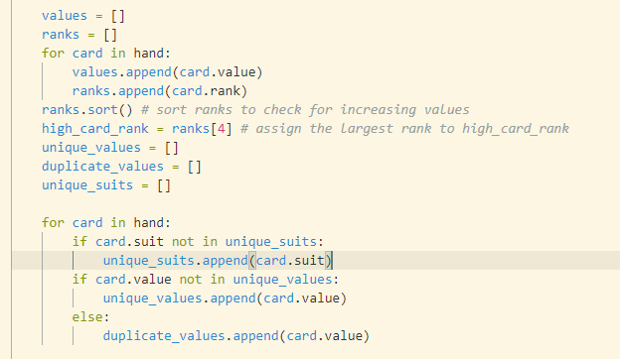
Poker_hands Modules: find_matches()
find_matches(hand) is called after each hand has been dealt.
Local variables are created to store card information from hand, and to check for unique and duplicate values
Will check first for Royal Flush, followed by descending hands
find_straights() is called within this function to check for rank continuity before checking for other types of hands
Function will calculate and return highest card rank, included within a tuple of three values, (name of hand, point value, high card rank)
return ("Three of a Kind", 45, high_card_rank)

Slide 9
find_matches() cont’d:
Check for Royal Flush/Flush
If 5 unique values and only one unique_suit:
if values == royal_flush set ({10, Jack, Queen, King and Ace})
Else
Return “Royal Flush”
return “Flush”
Point values returned are 135, and 75 respectively, plus highest card rank.
Call to find_straights() if above fails (most likely)

Slide 10
find_straights(ranks, unique_suits)
Check for ccontinuity with Aces first
Valid if ranks is either [10,11,12,13,14], or [2,3,4,5,14]
Sort ranks from high to low
Return (“Straight Flush”) if unique_values == 1, else return (“Flush)
Point values 120 or 60
Function will return None if no straights are found. Will exit this function and continue down find_matches()

Slide 11
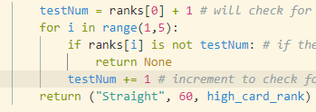
find_straights() cont’d: (No aces)
None if there’s a failure
Increment testNum
“Straight” if passed through for loop.

Slide 12
Back to find_matches()
Continue if there is no straight
if 4 unique values:
If 3 unique values:
If 2 unique values:
One Pair
Three of a kind if both duplicate values are the same
Two Pair otherwise
Four of a kind if all 3 duplicate values are the same
Full house otherwise
Return No Matches if no other hands are present

Slide 13
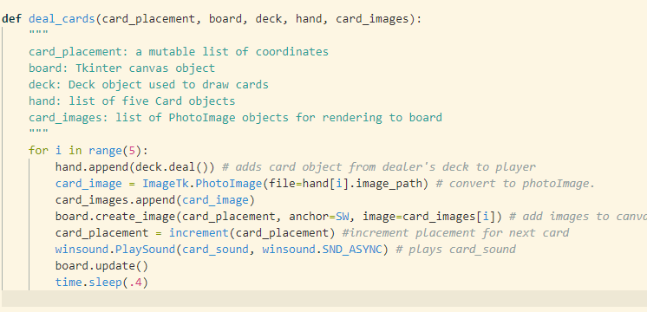
Rendering Images deal_cards()

Slide 14
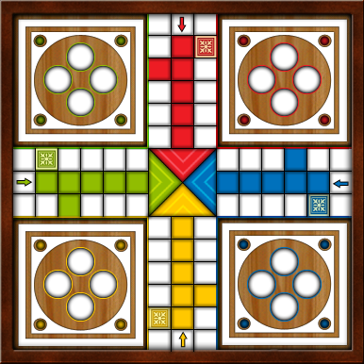
Game Demonstration

Slide 15
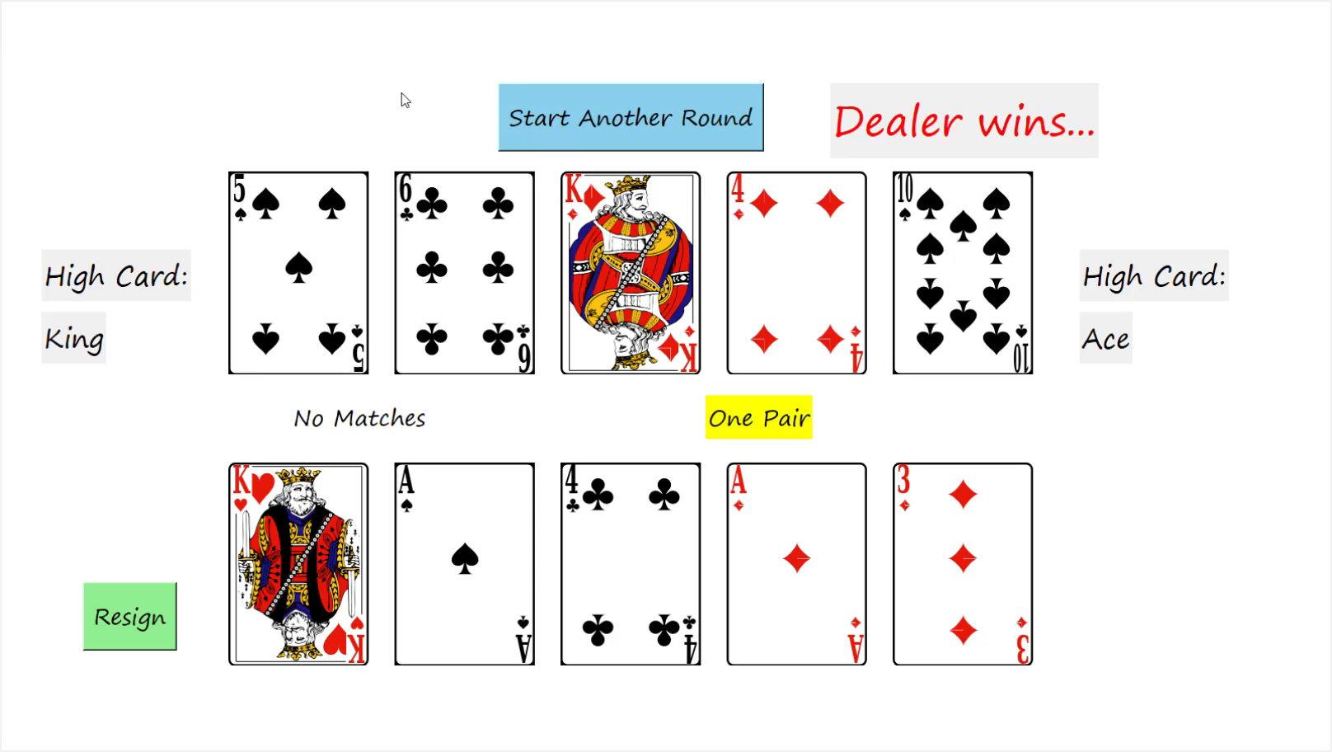

Slide 16
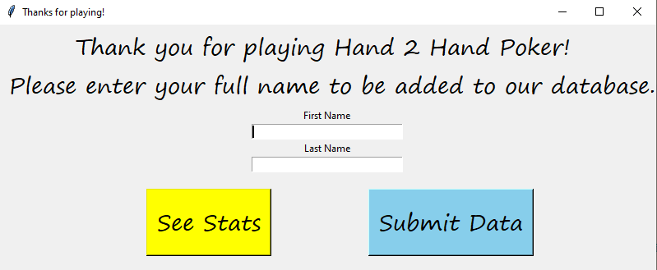
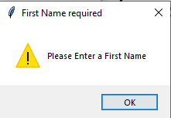
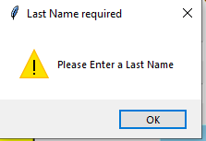
Resign():
Full name is required in order to
See Stats and submit data

Slide 17
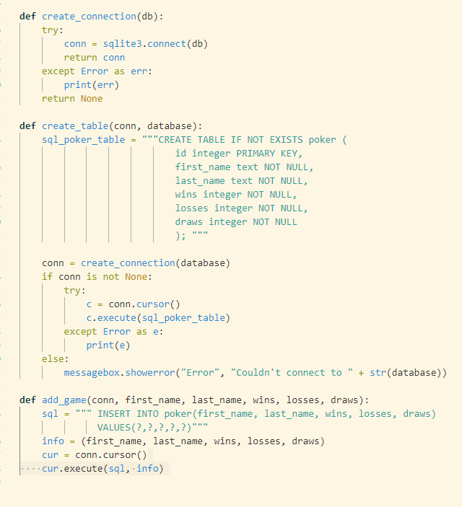
Database is created at the start of program
Once player selects Submit Data, his/her records (full name and win loss date) are added to the database

Slide 18
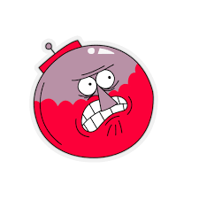
Getting my images to render
Incorporating sound effects!
It’s very addicting!
fun.

Slide 19

Disclaimer…

